Slide 1
The SQL Server Transaction Log for Developers
SQL Saturday Madison
April 7, 2018

Slide 2


SQL Saturday Madison: Silver Sponsors

Slide 3

SQL Saturday Madison: Gold Sponsor

Slide 4

SQL Saturday Madison: Gold Sponsor

Slide 5
SQL Saturday Madison After Party
Join us @6:30pm for some networking and fun. Appetizers provided.
Madison’s
119 King Street
Madison, WI 53703

Slide 6
Join your local WI Chapter
FoxPASS - Appleton, WI MADPASS - Madison, WI Western Wisconsin PASS - Eau Claire, WI
WausauPASS - Wausau, WI WI SSUG - Waukesha, WI

Slide 7
Save $$$ on your PASS Summit Registration
PASS Summit is the largest conference for technical professionals who leverage the Microsoft Data Platform.
November 6th – 9th Seattle, WA
Use this code to save $150 off your registration: SSDISHN1C
Use this code to get access to all 2017 Summit sessions: SQLSTRHN1C

Slide 8
About Me
Frank Gill
Senior Systems Engineer at Concurrency
19 years in IT, 11 as a SQL Server guy
Started my career as a COBOL programmer
Interested in all things internal
Volunteer at the Art Institute of Chicago
Email – skreebydba@gmail.com
Twitter - @skreebydba
Blog – skreebydba.com

Slide 9
What We Will Cover
ACID properties
What is the transaction log?
Transactions
Transaction log architecture
Virtual Log Files (VLFs)
Log growth
Log space reservation
Batching transactions
Rollback activity

Slide 10
ACID Properties
Atomicity – Transactions are all or nothing
Consistency – Transactions must leave the database in a consistent state
Isolation – Transactions cannot interfere with one another
Durability – A committed transaction must be persisted

Slide 11
What is the Transaction Log
One of at least two files created with a SQL Server database
Sequential file
Tracks all activity in the database
Database activity is run in transactions
The database stops if SQL Server cannot write to the log

Slide 12
Transactions
All SQL Server activity takes place in a transaction
BEGIN TRANSACTION…COMMIT TRANSACTION
A transaction with BEGIN…COMMIT coded is explicit
A transaction without BEGIN…COMMIT is implicit
SQL Server wraps implicit transaction in BEGIN…COMMIT
Default behavior is AUTOCOMMIT

Slide 13
Transaction Log Architecture
Physical transaction log file allocated on disk (.ldf)
Physical file is divided into virtual log files (VLFs)
VLFs can be reused
Transaction log is designed to be a circular file

Slide 14
Virtual Log Files
Can be free or active
Free VLF can be reused
Active VLFs contain log records SQL Server requires
Log records required for
Log backups
High availability
Rollback/rollforward activity

Slide 15
Virtual Log Files
VLF1
VLF2
VLF3
VLF4
Active
Free
Free
Free

Slide 16
Transaction 1 Commits
Tran1
VLF1
VLF2
VLF3
VLF4
Active
Active
Free
Free

Slide 17
Transaction 2 Commits
Tran1
Tran2
VLF1
VLF2
VLF3
VLF4
Active
Active
Active
Free

Slide 18
Transaction 3 Begins
Tran1
Tran2
Tran3
VLF1
VLF2
VLF3
VLF4
Active
Active
Active
Active

Slide 19
Log Backup or Checkpoint
Tran3
VLF1
VLF2
VLF3
VLF4
Free
Free
Active
Active

Slide 20
No Log Backup or Checkpoint
Tran1
Tran2
Tran3
VLF1
VLF2
VLF3
VLF4
VLF5
Active
Active
Active
Active
Active

Slide 21
Autogrowth
You want it on
Don’t work without a net

Slide 22
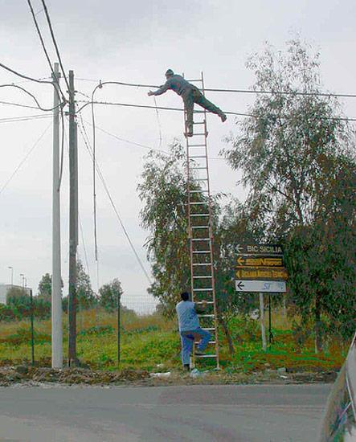
Autogrowth
http://pic.humor.li/p/humor-li-picture-14069.jpg

Slide 23
Autogrowth
You want it on
Don’t work without a net
Do set filegrowth to a fixed amount
This

Slide 24
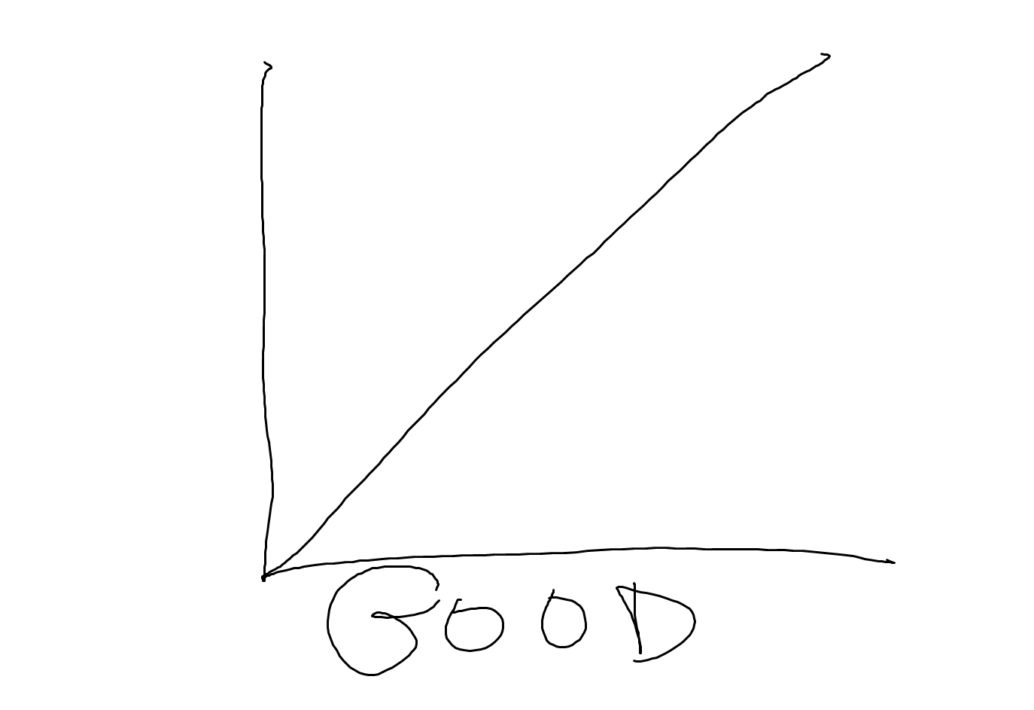
Autogrowth

Slide 25
Autogrowth
You want it on
Don’t work without a net
Do set filegrowth to a fixed amount
Not this

Slide 26
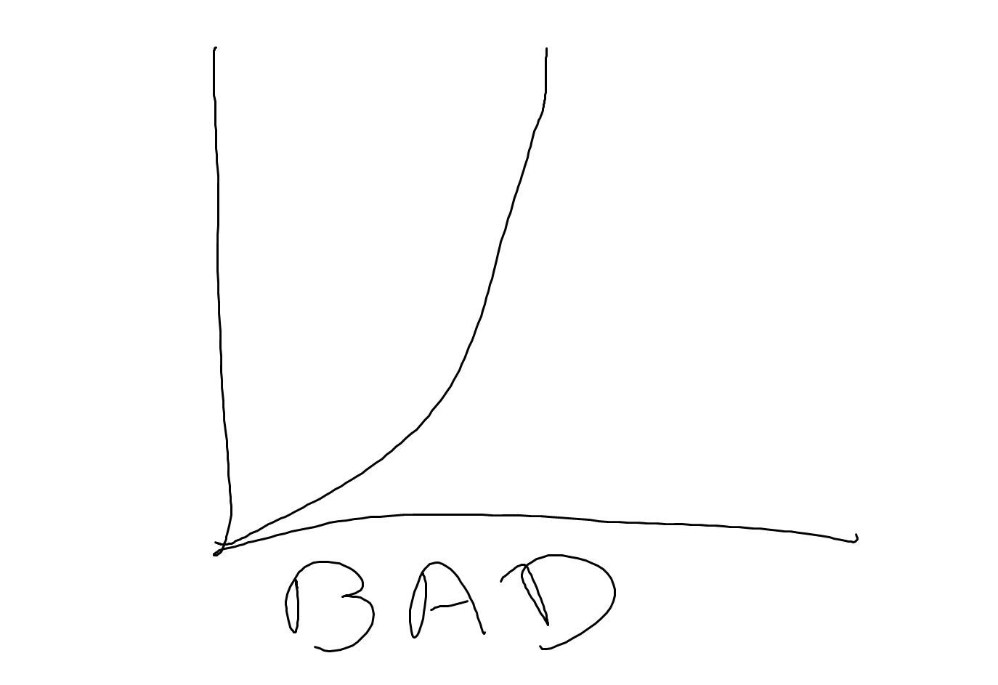
Autogrowth

Slide 27
Autogrowth
Demo

Slide 28
Why Not to Shrink Your Log
The log grew for a reason
The log will grow again
Log growth is extremely expensive
Space must be zeroed out

Slide 29
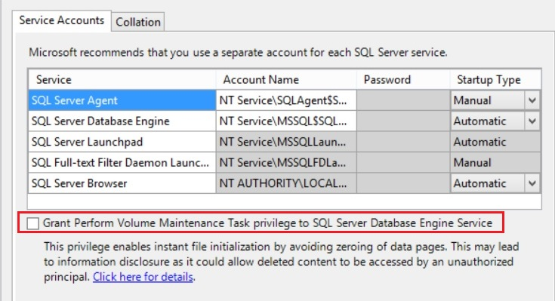
Log File Shrink

Slide 30
Why Not to Shrink Your Log
The log grew for a reason
The log will grow again
Log growth is extremely expensive
Space must be zeroed out

Slide 31
Small Log v. Big Log
Two databases
BigLog – 8GB Log with 1GB Growth
SmallLog – 8MB Log with 1MB Growth
Insert 100000 rows into both databases

Slide 32
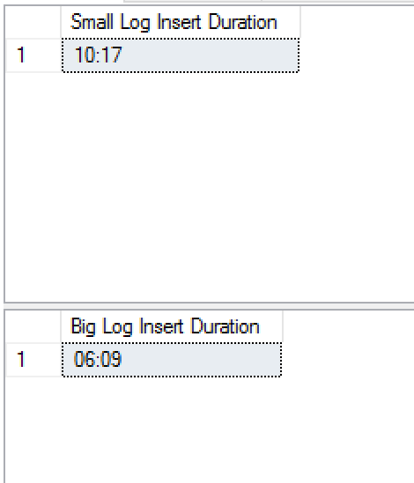
Small Log v. Big Log

Slide 33
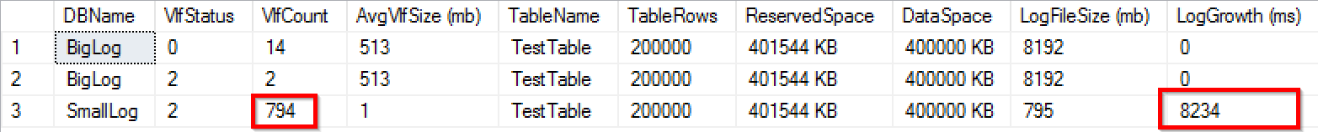
Small Log v. Big Log

Slide 34
Small Log v. Big Log
Small log has more VLFs
More VLFs make SQL Server work harder
Log growth makes SQL Server work harder
Let SQL Server work smarter

Slide 35
Log File Reservation
Transactions are all or nothing
SQL Server reserves space for roll back
Reserved space is released on commit
Batch your transactions

Slide 36
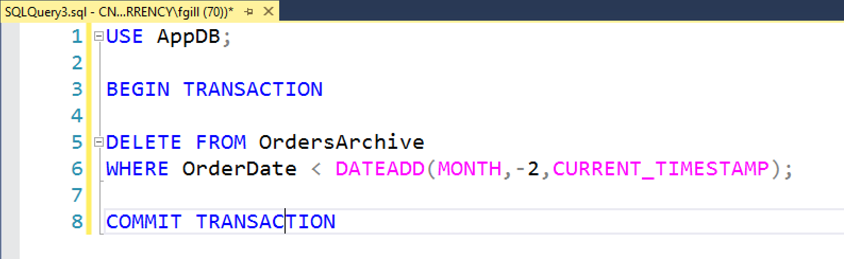
Log File Reservation
Application writes orders
The business has retained two years of archived orders
The business has decided to only retain two month of archived orders

Slide 37
Log File Reservation
Demo

Slide 38
Rollback
SQL Server reserves space for rollback
On rollback, an anti-operation is generated for every operation
For inserts, delete
For deletes, insert
For updates, update

Slide 39
Resources
Transaction Log Architecture - https://docs.microsoft.com/en-us/sql/relational-databases/sql-server-transaction-log-architecture-and-management-guide
Paul Randal on the Transaction Log - https://www.sqlskills.com/blogs/paul/category/transaction-log/

Slide 40
About Me
Frank Gill
Senior Systems Engineer at Concurrency
18 years in IT, 10 as a SQL Server guy
Started my career as a COBOL programmer
Interested in all things internal
Former co-president of the Chicago SQL Server User Group
Volunteer at the Art Institute of Chicago
Email – skreebydba@gmail.com
Twitter - @skreebydba
Blog – skreebydba.com

